Slide 1
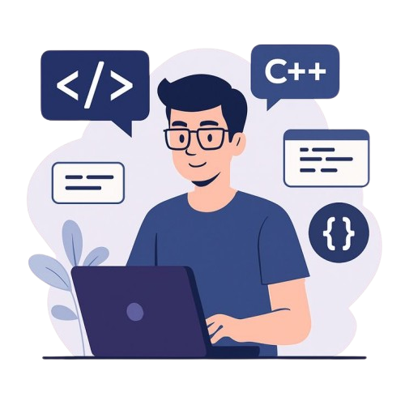


ENGINEERING
SOFTWARE

Slide 2
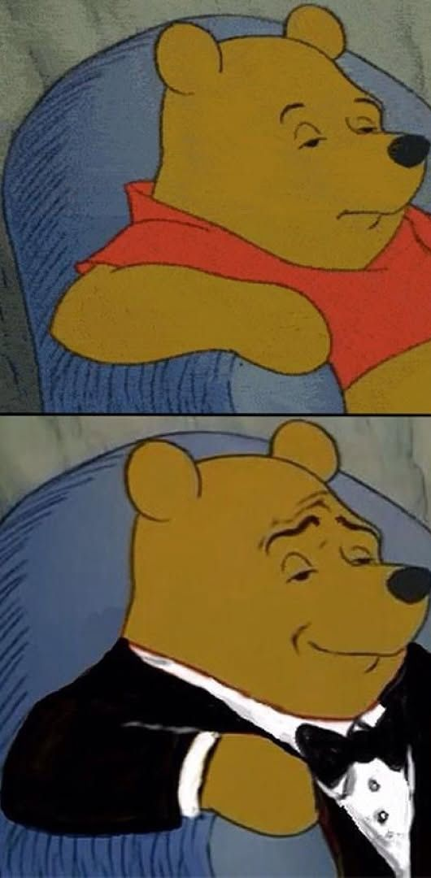
SOFTWARE ENGINEERING
Software Engineering is the process of designing, developing, testing, and maintaining software.
It is a systematic and disciplined approach to software development that aims to create high-quality, reliable, and maintainable software.
Programmer
Software Engineer

Slide 4








SOFTWARE
Software consists of computer programs that instruct the execution of a computer.
Software provides a single interface to the user to obtain results for a variety of requests.
Software is the controlling unit of the hardware.

Slide 5

SOFTWARE
Software acts as an interface between the user and the hardware.
Software or hardware alone is useless.
$$Software =computer program + procedures+rules+associated documents+data$$

Slide 6
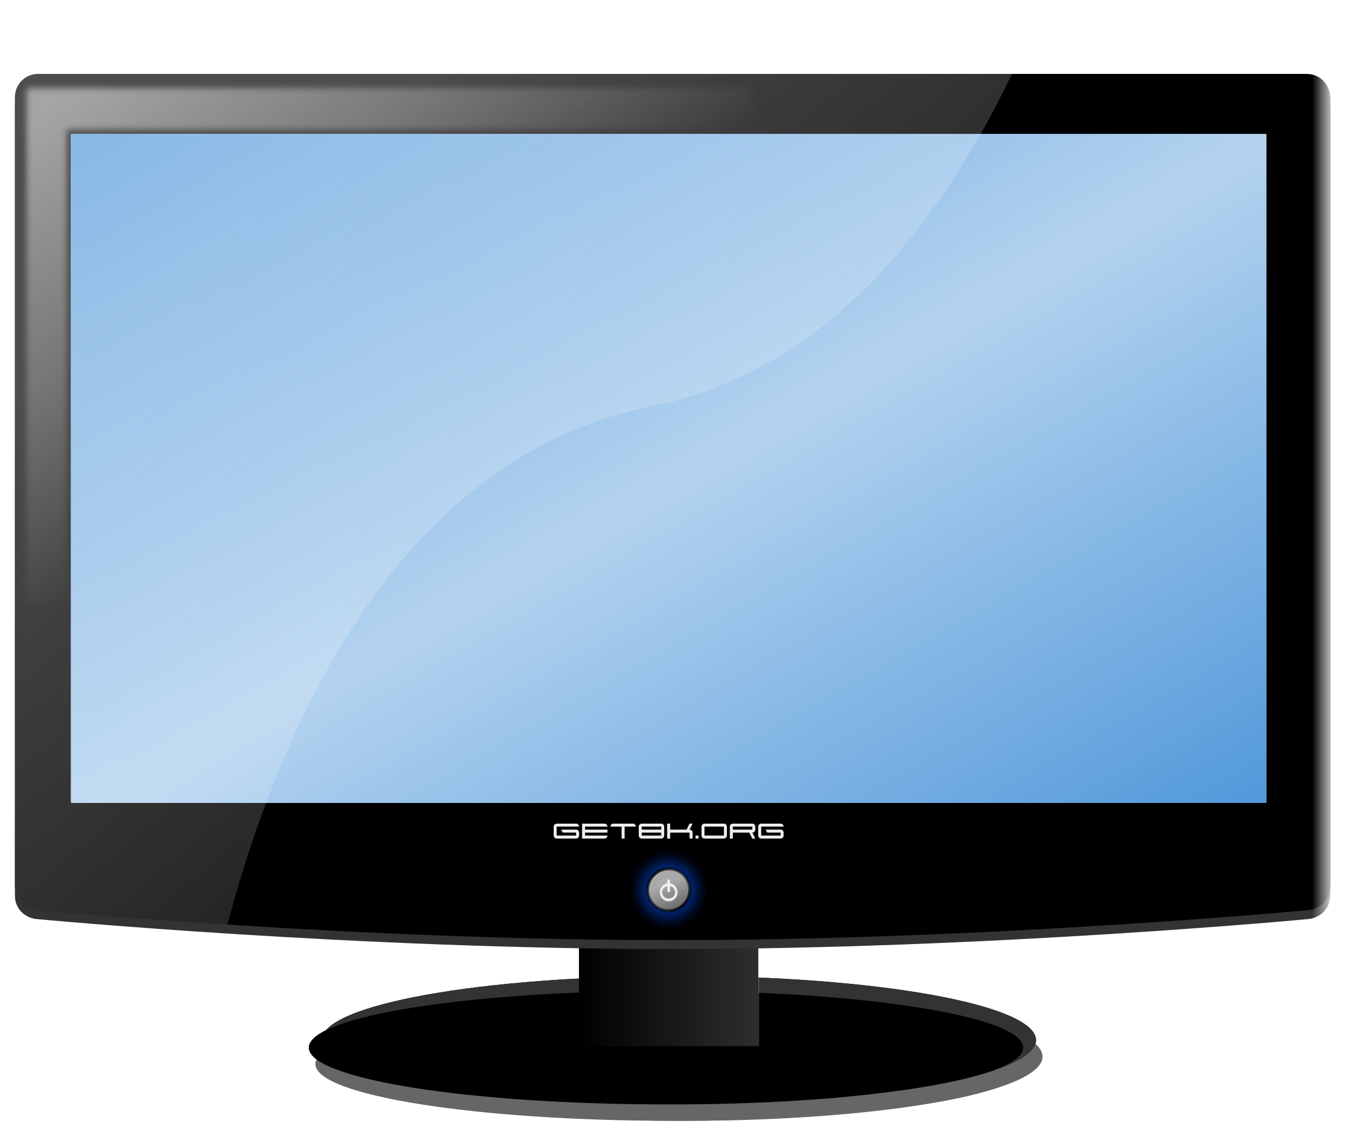

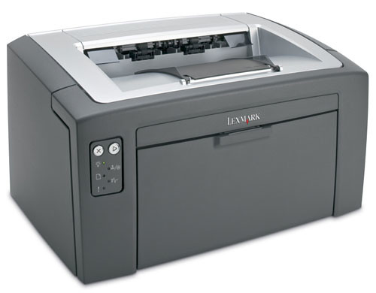
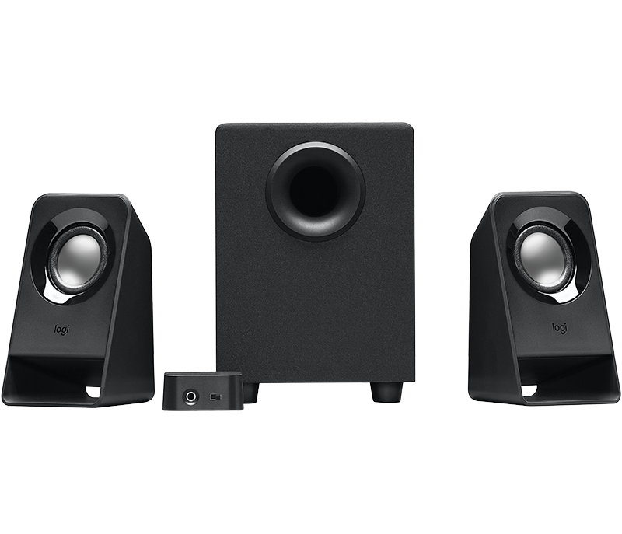

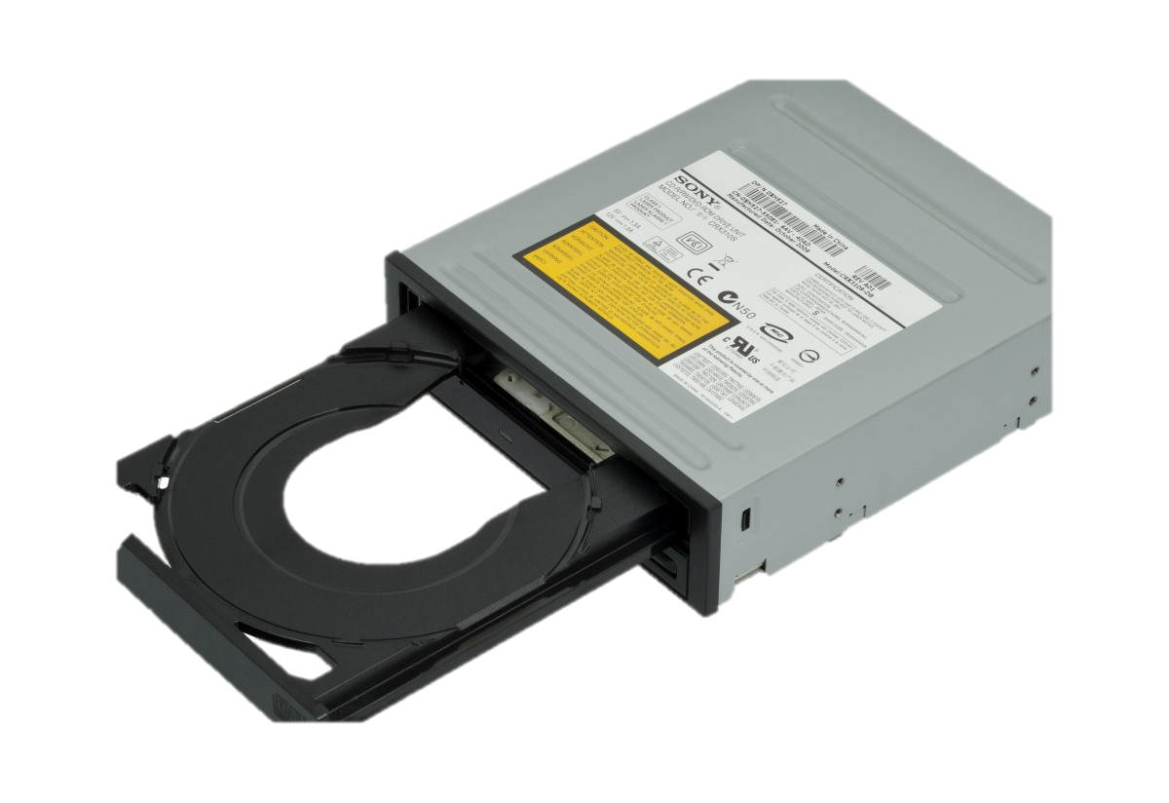
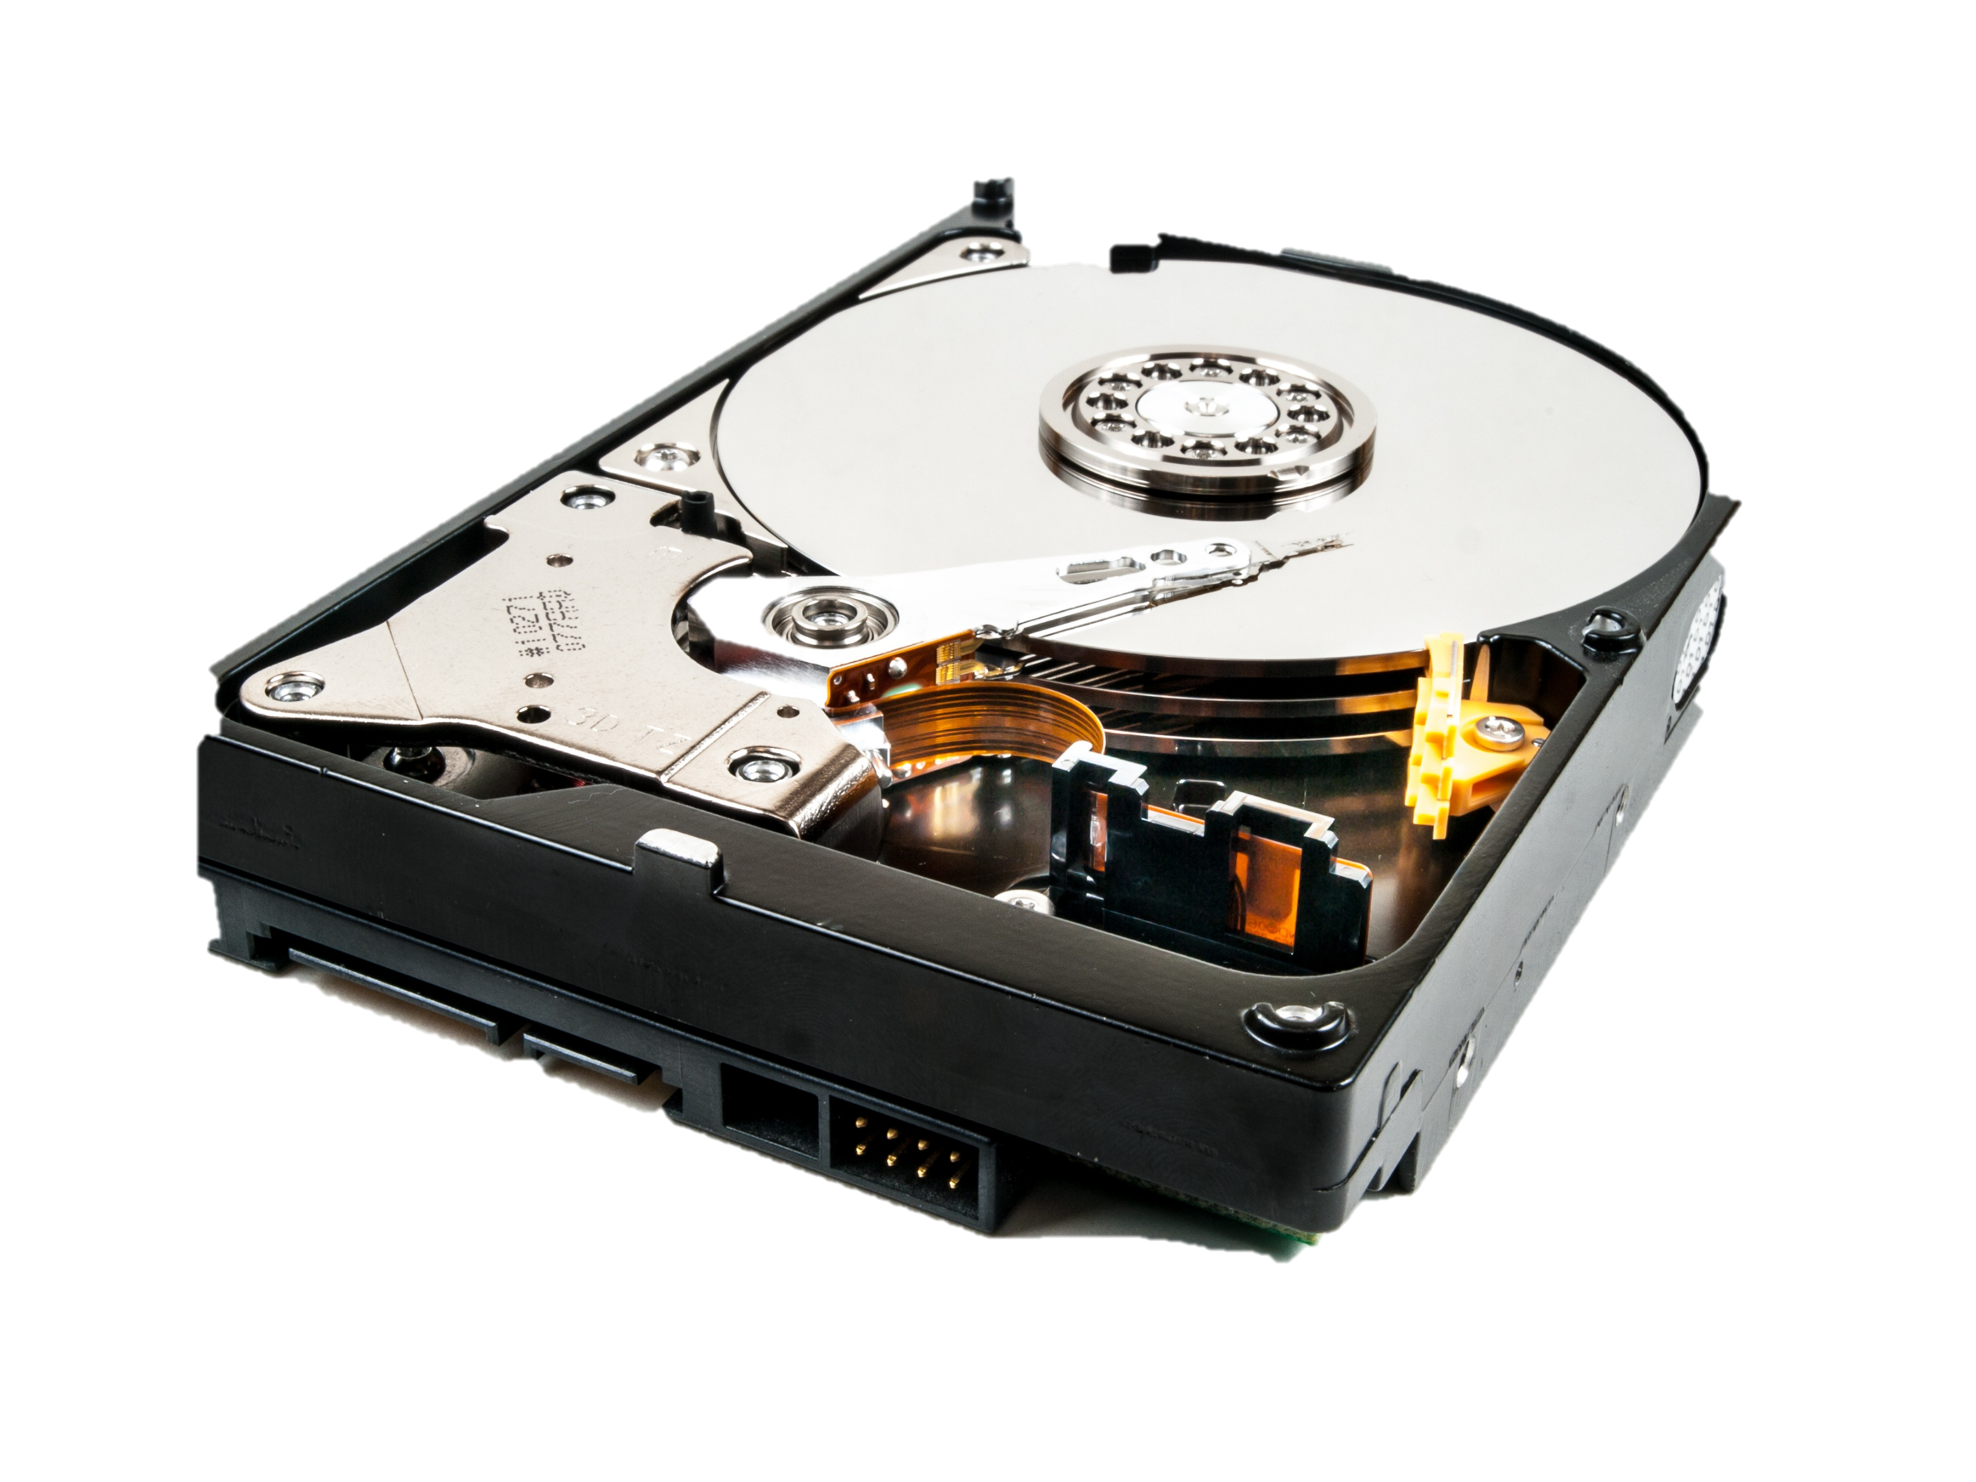
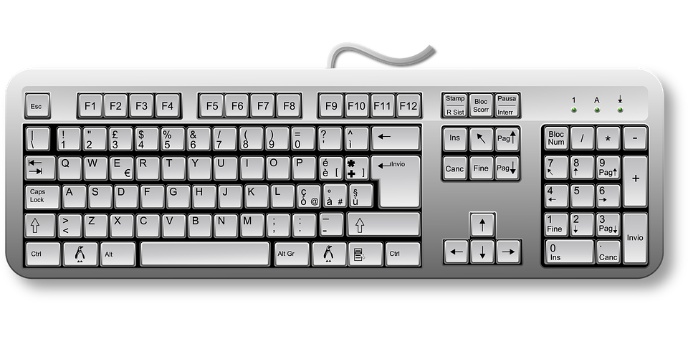
SOFTWARE
HARDWARE

Slide 7







Software
System Software
Application Software
System Software controls the operation of the hardware components
Eg: Operating Systems, utility programs and device drivers
Application software is a type of computer program designed to help users perform specific tasks or functions.
Eg: Games, Browsers, Word processing software …

Slide 8
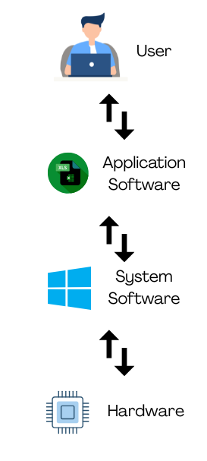
WORK FLOW

Slide 9
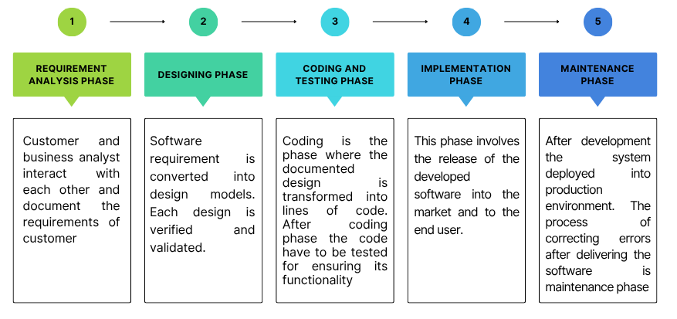
PHASES IN SOFTWARE DEVELOPMENT

Slide 10
REQUIREMENT ANALYSIS PHASE
The first phase of SDLC where the customer will explain how and what the end product should perform.
The expert team analyzes the possibilities and impact of implementing the requirement.
It is easy to solve a problem in requirement in requirement analysis phase.

Slide 11
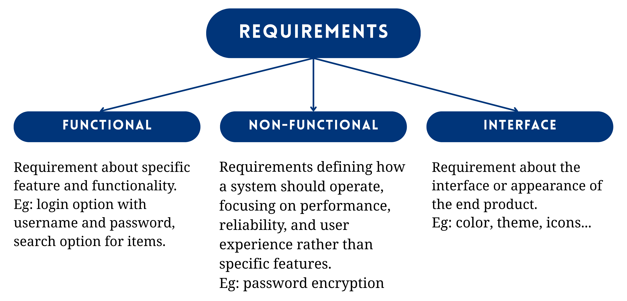
TYPES OF REQUIREMENT

Slide 12
DESIGNING PHASE
The software requirement is converted into design.
The designing phase converts the business requirement into technical requirement.
UML is the modeling language used to model software requirement.
Design has no functionality but only the structure of the product.

Slide 13
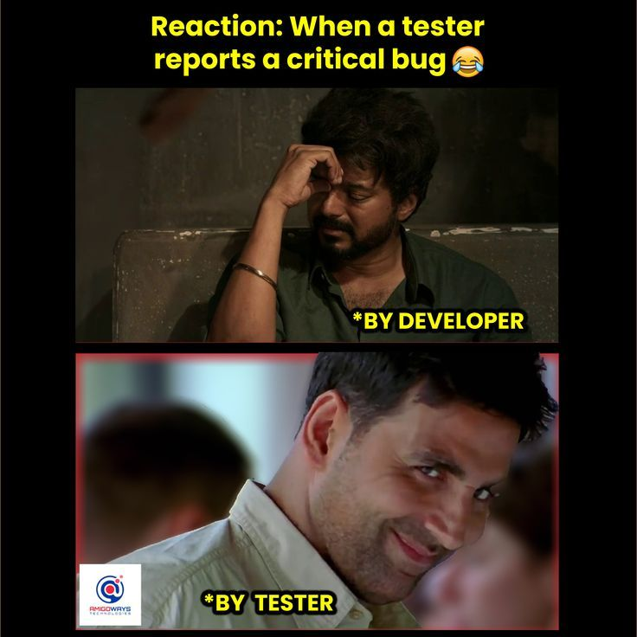
CODING AND TESTING PHASE
In coding phase, the design is transformed into lines of code in programming language.
After coding phase is complete the code have to be tested for ensuring its correct functionality.
Testing is carried out by a separate team of experts.

Slide 14
IMPLEMENTATION PHASE
After successful testing the software is released into the market and end user.
The product is implemented in customers domain.

Slide 15
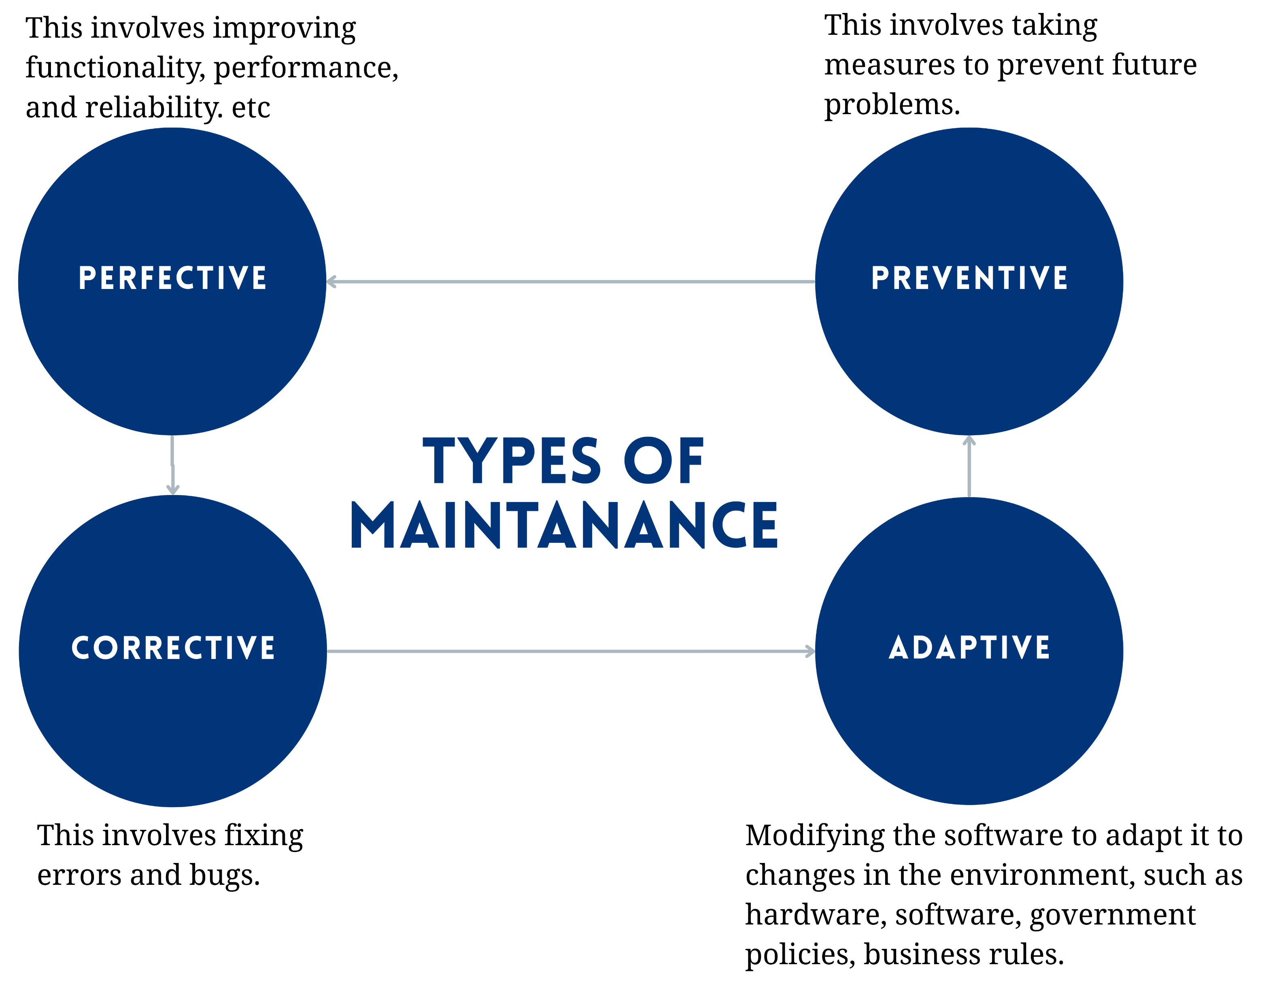
MAINTENANCE PHASE
Software maintenance is the core aspect of software engineering.
The process of modifying the system after release to correct the fault, improve the performance and adapt to the changing environment is known as maintenance.
All the changes during the maintenance is well documented

Slide 16
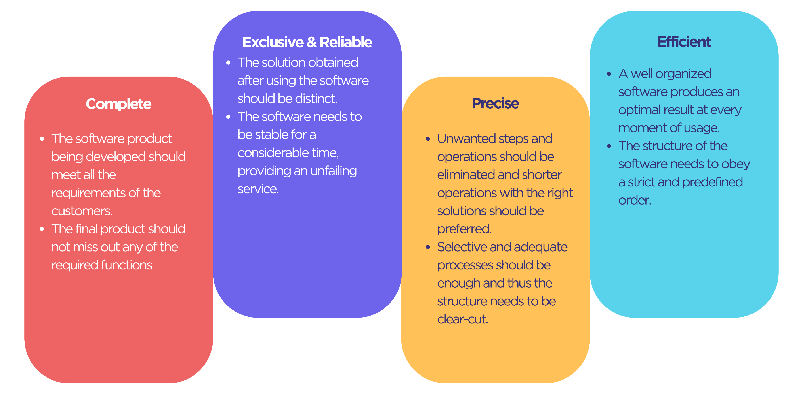
SOFTWARE CHARECTERISTICS

